Slide 1
Your Future is the Main Event
11th Grade - College & Career Planning & Goal Setting
May 10-14, 2021

Slide 2
Agenda
How Covid-19 has affected college admissions
Essay topics – Common App vs. Apply Texas
Free & Reduced Lunch…More than a Free Meal
Register for the SAT
Register for the ACT
What are your future goals and what does your timeline & deliverables for achieving those goals look like NOW
**Referring to the information presented at the 11th grade CCR session, “Strategize how you will navigate the college application process considering the test optional, test blind, & TSIA2 testing policies. Provide an outlined plan in either 2 full paragraphs or a 3 slide Powerpoint."

Slide 3
4 quarters to college admission Readiness
Quarter 1
Quarter 2
Quarter 1 – June to August
College Tests (Register, Study, & Take Test)
Apply for SAT/ACT fee waivers - See instructions below
During registration add colleges ( 4+ that you can send your scores to without an additional fee)
We recommend that you take the SAT & ACT 2 times by Oct of 2021.
Even though, many college are test blind or test optional - See List @ https://www.fairtest.org/university/optional
Tour colleges you are considering, per your “Colleges I’m Thinking About” List
College Essays ( Most require 1-3 and many require supplemental essay questions for majors/scholarships)
College Resume ( Must do to obtain letters of rec, scholarships, and admission apps)
https://www.indeed.com/career-advice/resumes-cover-letters/college-admissions-resume
Includes a free tool to upload resume and get feedback – Use this!
Set-up Student Account ( Takes 15 minutes)
CommonApp.org – See video on slide 7
ApplyTexas.org – See video on slide 8
Quarter 2 – September to November
Oct 1st Apps Open with Jan 1 - March 31st Deadlines
Submit FAFSA Forms
Submit TASFA Forms
CSS Profile for Commonapp.org
Most deadlines are between January 1 & March 31
Early Action/Early Decision/Rolling Decision Applications Submitted
Visit colleges and take a tour of campus and department your major is housed in
2 excused college visit days a semester
Schedule visits on Visitor/Admission Center websites at least 1 month ahead
Apply for Housing/Dorms

Slide 4
4 quarters to college admission Readiness
Quarter 3
Quarter 4
Quarter 3 – December to February
Regular/rolling decision & priority date applications submitted
Colleges with priority dates are usually signaling $$ deadlines.
I.e. - If you want to be considered for scholarships apply by the priority deadline or before
Many colleges with Dec 1 Admission Application deadlines have Oct 1, Oct 15, & Nov 1 priority deadlines.
Quarter 4 – March to May
Matriculation
TSIA2 testing
Bacteria meningitis vaccine
Schedule New Student Orientation
Confirm housing

Slide 5
Essay Topics Common App vs. Apply Texas
Apply Texas - Https://www.Applytexas.Org/adappc/html/preview20/essay_preview.Html
Topic A - tell us your story. What unique opportunities or challenges have you experienced throughout your high school career that have shaped who you are today?
Topic B - most students have an identity, an interest, or a talent that defines them in an essential way. Tell us about yourself.
Topic C - you've got a ticket in your hand - where will you go? What will you do? What will happen when you get there?
Topic D - please note: the essay in this section is specific to certain college majors and is not required by all colleges/universities that accept the apply texas application. If you are not applying for a major in architecture, art, art history, design, studio art, visual art studies/art education, you are not required to write this essay.
Personal interaction with objects, images and spaces can be so powerful as to change the way one thinks about particular issues or topics. For your intended area of study (architecture, art history, design, studio art, visual art studies/art education), describe an experience where instruction in that area or your personal interaction with an object, image or space effected this type of change in your thinking. What did you do to act upon your new thinking and what have you done to prepare yourself for further study in this area?

Slide 6
Apply Texas – Additional Essay Prompts
UT Short Answer Essay Requirements
As part of ApplyTexas, all freshman applicants will also respond to three short-answer questions. Answers are limited to no more than 40 lines, or about 250 – 300 words.
Short Answer 1: Career Plans
Why are you interested in the major you indicated as your first-choice major?
Short Answer 2: Leadership
Leadership can be demonstrated in many ways. Please share how you have demonstrated leadership in either your school, job, community, and/or within your family responsibilities.
Short Answer 3
Please share how you believe your experiences, perspectives, and/or talents have shaped your ability to contribute to and enrich the learning environment at UT Austin, both in and out of the classroom.
Optional Short Answer
Please share background on events or special circumstances that may have impacted your high school academic performance.
Texas A&M University- Short answer question for Engineering majors
Engineering Essay: Describe your academic and career goals in the broad field of engineering (including computer science, industrial distribution, and engineering technology). What and/or who has influenced you either inside or outside the classroom that contributed to these goals?

Slide 7
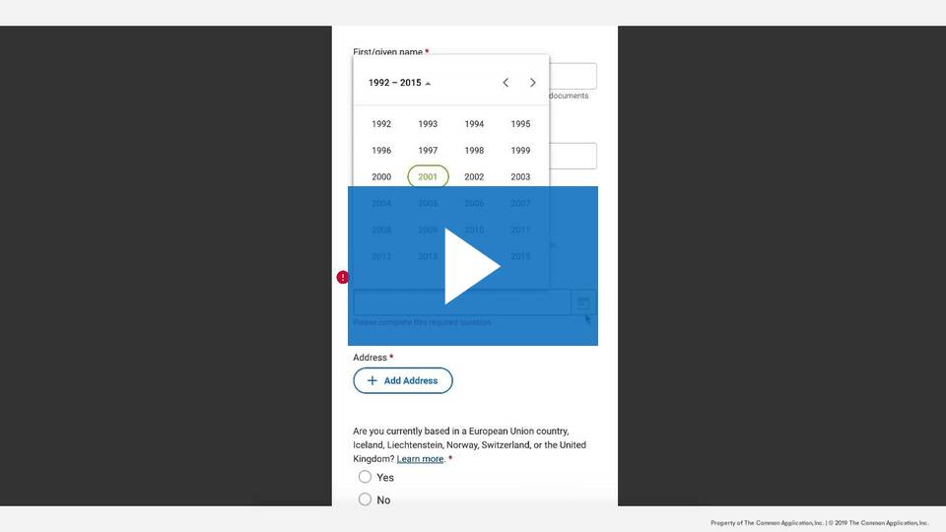
CommonApp.org
Common App Essay Prompts
Create Common App Account
Common app - https://www.Commonapp.Org/blog/2021-2022-common-app-essay-prompts
Below is the full set of essay prompts for 2021-2022.
Some students have a background, identity, interest, or talent that is so meaningful they believe their application would be incomplete without it. If this sounds like you, then please share your story.
The lessons we take from obstacles we encounter can be fundamental to later success. Recount a time when you faced a challenge, setback, or failure. How did it affect you, and what did you learn from the experience?
Reflect on a time when you questioned or challenged a belief or idea. What prompted your thinking? What was the outcome?
Reflect on something that someone has done for you that has made you happy or thankful in a surprising way. How has this gratitude affected or motivated you?
Discuss an accomplishment, event, or realization that sparked a period of personal growth and a new understanding of yourself or others.
Describe a topic, idea, or concept you find so engaging that it makes you lose all track of time. Why does it captivate you? What or who do you turn to when you want to learn more?
Share an essay on any topic of your choice. It can be one you've already written, one that responds to a different prompt, or one of your own design.
Press Play

Slide 8
Applytexas.org
ApplyTexas.org App Essay Prompts
Create ApplyTexas.org App Account
Common app - https://www.Commonapp.Org/blog/2021-2022-common-app-essay-prompts
Below is the full set of essay prompts for 2021-2022.
Some students have a background, identity, interest, or talent that is so meaningful they believe their application would be incomplete without it. If this sounds like you, then please share your story.
The lessons we take from obstacles we encounter can be fundamental to later success. Recount a time when you faced a challenge, setback, or failure. How did it affect you, and what did you learn from the experience?
Reflect on a time when you questioned or challenged a belief or idea. What prompted your thinking? What was the outcome?
Reflect on something that someone has done for you that has made you happy or thankful in a surprising way. How has this gratitude affected or motivated you?
Discuss an accomplishment, event, or realization that sparked a period of personal growth and a new understanding of yourself or others.
Describe a topic, idea, or concept you find so engaging that it makes you lose all track of time. Why does it captivate you? What or who do you turn to when you want to learn more?
Share an essay on any topic of your choice. It can be one you've already written, one that responds to a different prompt, or one of your own design.
Press Play

Slide 9
Free & Reduced Lunch…More than a Free Meal

Slide 10
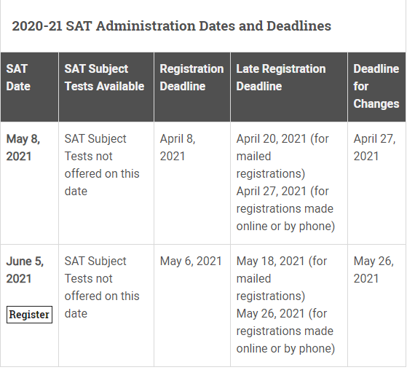
SAT – www.College Board.org
More Covid-19 updates regarding SAT can be found @ https://pages.collegeboard.org/sat-covid-19-updates :
Free SAT Prep - https://www.khanacademy.org/sat

Slide 11
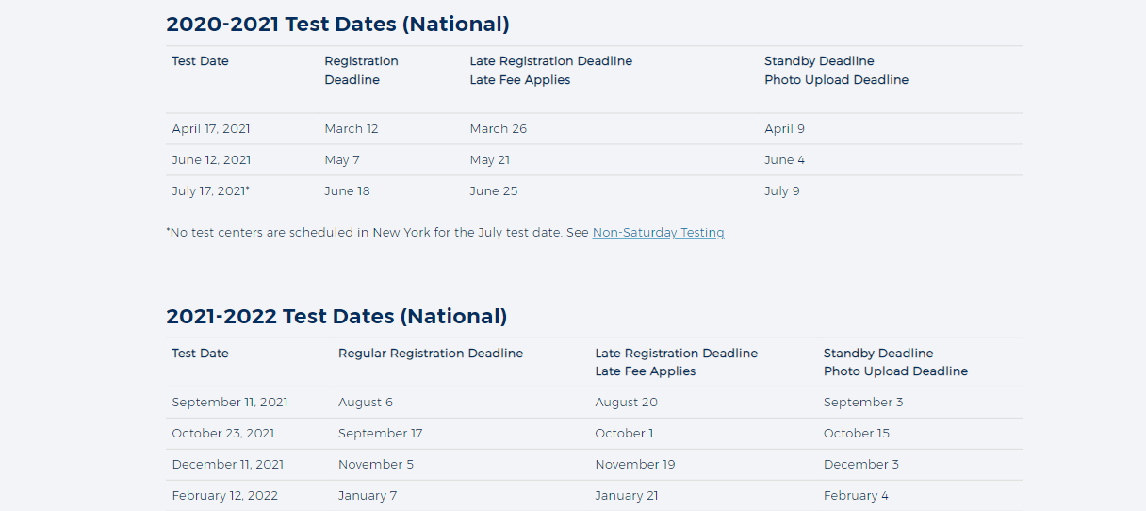
ACT– www.ACT.org
COVID-19 Updates - Frequently Asked Questions
The safety of students and test center staff is ACT’s top priority. ACT has rescheduled its April 4 national test date to June 13 across the U.S. in response to concerns about the spread of the coronavirus (COVID-19). All students registered for the April 4 test date will receive an email from ACT in the next few days informing them of the postponement and instructions for free rescheduling to June 13 or a future national test date.
All students registered for the April 4 test date will receive an email from act in the next few days informing them of the postponement and instructions for free rescheduling to June 13 or a future act national test date.
When are the next ACT national test dates? - The next ACT national test dates are June 13 and July 18.
What will happen if students cannot take the ACT on one of the future......test dates or don’t wish to reschedule their test? - Students who can’t or don’t wish to reschedule may receive a refund of their April registration fee.
I registered with a Fee Waiver, do I have to pay any fees to......change my test date? - You can log into your ACT account and make a test date change without incurring any fee because you used a fee waiver.
Can I still request a TIR for Special Testing or Non-Saturday Testing?
Yes, ACT will be offering an option for Non-Saturday and Special testing for the June 2020 test date.
Register Today & Take 2 times no later than Oct of your 12th Grade year - https://www.act.org/content/act/en/products-and-services/the-act/registration.html
Free ACT Practice
https://www.act.org/content/act/en/products-and-services/the-act/test-preparation/math-practice-test-questions.html?page=0&chapter=0
http://www.act.org/content/act/en/products-and-services/the-act/test-preparation/act-academy.html

Slide 12
QuestBridge Scholarship
https://www.questbridge.org/high-school-students/national-college-match
Are you a low-income high school senior who has excelled academically, but feels that the nation’s best colleges are financially out of reach? The QuestBridge National College Match can be your pathway to a top college. Through this college and scholarship application process, you can apply for free to the nation’s best colleges and be considered for early admission and a full four-year scholarship from the college.
If you are on Fee or Reduced Lunch or qualify for it or received any type of social services benefits, then you should consider applying
The Match Scholarship is offered as part of a generous financial aid package provided by the college that covers the cost of attendance, including:
Tuition and fees
Room and board
Books and supplies
Travel expenses

Slide 13
Find your College Fit & Your Timeline for College Research
Find Your Fit by completing this step by step activity:
https://bigfuture.collegeboard.org/find-colleges/how-to-find-your-college-fit/college-search-step-by-step
Timeline for college research
https://college-connections.com/juniors-college-prep-spring-semester-to-do-list/

Slide 14
How to FInd Scholarships in Naviance
Scholarship Match or National Scholarship search
After logging Into Naviance via Clever Click on “Colleges” and then click on “Scholarships & Money”
Then, click Scholarship Match or National Scholarship Search
must complete a brief survey to Identify scholarships that you qualify for
The list shows the reason for the matching criteria and an application deadline.

Slide 15
Start this Summer
Start this Summer
Start This summer
Start this Summer
Start this Summer

Slide 16
Have Questions?
Feel free to book a Teams meeting with me.
You can now book and manage appointments using our booking page for July 15th 2021 & beyond as I will be unavailable starting June 9th due to summer break:
https://outlook.office365.com/owa/calendar/ElkinsHSCCRAdvisor@fortbend.onmicrosoft.com/bookings/

